Slide 1
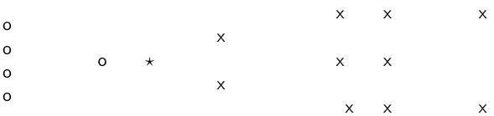
Question 1
Class 1 = Circle , Class 2 = Cross
How is star classified by:
(i) 1-NN (ii) 3-NN (iii) 9-NN (iv) 15-NN (v) Rocchio?
1

Slide 2
Question 1 Solution
How is star classified by:
1-NN Circle
3-NN Cross
9-NN Circle
15-NN Cross
(v) Rocchio Circle
2

Slide 3
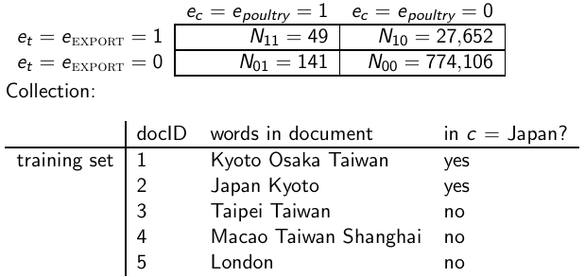
Question 2
(i) Compute the “export”/POULTRY contingency table for the
“Kyoto”/JAPAN in the collection given below.
(ii) Make up a contingency table for which MI is 0 – that is, term and class are independent of each other.
3

Slide 4
Q 2 Solution
Part 1
N11 = 2 | N10 = 0
N01 = 0 | N00 = 3
Part 2: N11 = N01 and N10 = N00; term is present in half docs of each class
N11 = 3 | N10 = 5
N01 = 3 | N00 = 5
OR N01 = 0 and N00 = 0 , term is present in all docs in all classes
N11 = 2 | N10 = 3
N01 = 0 | N00 = 0

Slide 5
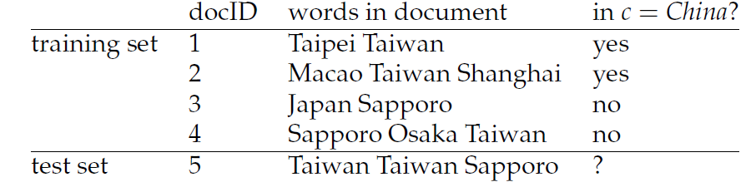
Question 3
Based on the data in Table
(i) apply the multinomial Naive Bayes classifier to the test document,
(ii) apply the Bernoulli NB classifier to the test document.

Slide 6
Q 3 Solution
Multinomial NB
P (C | d5 ) = P( C) P( Taiwan | C) P( Taiwan | C) P( Sapporo| C)
= 0.5 *0.25*0.25*1/12 = 0.0026
P (Not C | d5 ) = P(Not C) P( Taiwan | Not C) P( Taiwan | Not C) P( Sapporo| Not C)
= 0.5 *1/6*1/6*0.25 = 0.00347
d5 is classified in Class Not China

Slide 7
Q 3 Solution
Bernoulli NB
P (C | d5 ) = P( C) P( Taiwan | C) P( Sapporo| C) (1 – P(Taipei | C ))
(1 –P(Macao| C )) (1 – P(Taipei | C )) (1 – P(Shanghai | C )) (1 – P(Japan| C )) (1 – P(Osaka | C ))
= 0.00659

